Slide 1
Thursday, March 29, 2018
Write In Your Agenda:
Write In Your Monitoring Log:
CW:
Finish Not All Alien Invaders Are From Outer Space Power Point and Note Sheet.
Review 3rd Quarter Ecology Final.
HW:
Have Monitoring Log completed and signed.
Response to Warm-Up:
Of the “Alien Invaders” we covered yesterday, which one do you think poses the most risk? Why?
You will need:
Pencil.
Agenda.
Monitoring Log.
Not All Alien Invaders Are From Outer Space Power Point and Note Sheet.

Slide 2
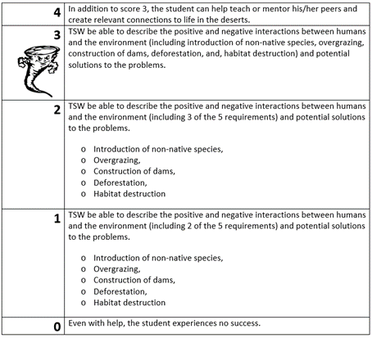
Learning Goal and Scale
TSW be able to describe the positive and negative interactions between humans and the environment (including deforestation, construction of dams, introduction of non-native species, overgrazing, habitat destruction) and potential solutions to the problems.
Biological Accumulation Comic Strip

